Slide 1
Query For Speed and Performance: It’s Architectural
Jeff Putz
jeff@popw.com | @jeffputz

Slide 2
Agenda
About me
Assumptions
The problem
Trace to find your bottleneck
Derived vs. pre-calculated data
The advantage of being “SQL dumb”
A real life example
Hidden evil: The leaky abstraction of IQueryable and grid controls, plus Transaction levels and deadlocks
Questions

Slide 3
About me
Broadcaster gone software hack, since 1999-ish.
Currently a Technical Architect at AgileThought.
See also: Microsoft, SeaWorld Parks & Entertainment, Humana, Progressive, Insurance.com (RIP).
Open source: POP Forums https://github.com/POPWorldMedia/POPForums
Blog http://weblogs.asp.net/jeff
Site for roller coaster nerds:
http://coasterbuzz.com

Slide 4
Assumptions
You’re here to hear about a specific problem that is found everywhere in the wild.
Conceptually, this can apply to most platforms.
We’re using SQL Server as a backend.
For some issues described, .NET is our dev platform.
This story is based on a real project, but the names have been changed to protect the guilty. First concrete example is a science experiment, but I’ll show results of the real project.
This is a lot to cover for in 50 minutes!

Slide 5
The problem
You build the best application ever: A line-of-business app for a Fortune 500.
The app grows in usage to 50+ users.
It stops working.
Throwing hardware at it doesn’t help.
You never managed to get the business to understand that high performance is a feature.
Your self-esteem is suffering.

Slide 6


Slide 7
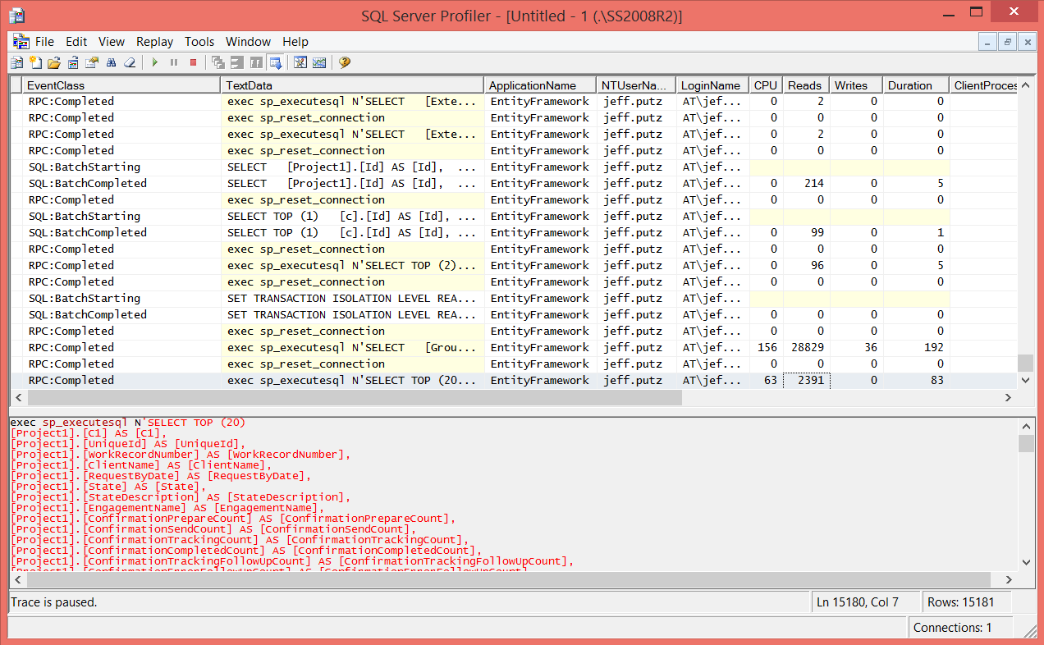
Trace to find your bottleneck
Behold, SQL Server Profiler!

Slide 8
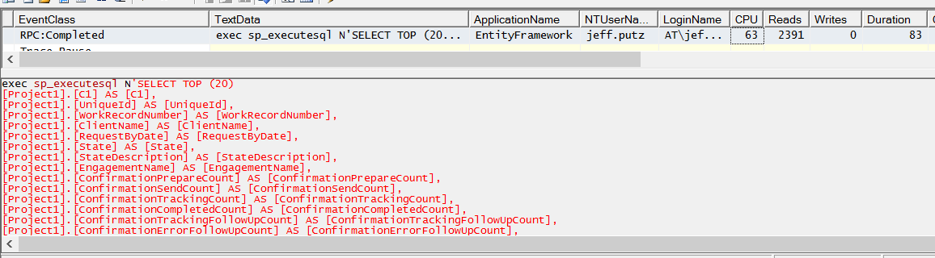
Trace to find your bottleneck
Look for the longest running things.
Look for the most reads and writes.
Look for the crazy CPU usage.
Copy the query, execute in SSMS and check execution plan

Slide 9
Derived vs. pre-calculated data
Ask yourself: Should I calculate data on every request, for every user, or should I do it once and store it when the underlying data changes?
Derived:
Convenient, inexpensive to implement, requires no additional app logic.
Is often encapsulated in database logic (view or stored procedure).
Aggregation has a performance cost.
Easy to expose for sorting and filtering abstractions (like grid controls).
Pre-calculated:
Requires refresh logic any time underlying data changes.
Code has to be well-factored and organized.
Typically involves flat, indexed data structures.
Crazy fast because it’s flat. (NoSQL for all teh thingz!!!!!111!)
Sorting and filtering can get complicated when aggregates get involved.

Slide 10
Derived vs. pre-calculated data
Getting to pre-calculated data is easier when you’re coding from scratch.
All updates to your data should occur inside the same code, with rules that trigger the updates for the aggregated and pre-calculated data. Be well-factored!
Older systems that update data from multiple angles and not shared code make the shift hard.

Slide 11
The advantage of being “SQL dumb”
If you don’t know how to do a JOIN with aggregates and sums and such, you’re more likely to calculate that data more frequently, and as the underlying data changes.
Logic and business rules are less likely to end up in the database as views or stored procedures.
Denormalization happens, but that isn’t a bad thing. Disk space is cheap. The only risk is making sure the redundant data is consistently updated from your application.

Slide 12


Slide 13
A real-life example
POP Forums: 1999
Jeff has almost no experience with relational databases.
The list of forums should include the last post time, last post user, the number of topics and the number of posts in each forum.
Jeff feels like there should be some magic SQL that can get all of this, but he doesn’t know what it is.
Being a n00b, he updates those numbers every time a post is created, deleted or moved.
Jeff doesn’t know it, but he preempts a future performance issue.

Slide 14

A real-life example
The would-be solution for an aggregated bit of SQL magic:
WITH test_table_ranked AS (
SELECT ForumID, LastPostName, LastPostTime,
ROW_NUMBER() OVER (PARTITION BY ForumID ORDER BY LastPostTime DESC) AS most_recent
FROM pf_Topic
)
SELECT f.ForumID, f.CategoryID, f.Title, f.Description, f.IsVisible,
f.IsArchived, f.SortOrder, tc.TopicCount, pc.PostCount, lastposts.LastPostTime,
lastposts.LastPostName, f.UrlName, f.ForumAdapterName, f.IsQAForum
FROM pf_Forum AS f
JOIN (SELECT t.ForumID, COUNT(*) AS TopicCount FROM pf_Topic t
WHERE t.IsDeleted = 0 GROUP BY t.ForumID) AS tc
ON tc.ForumID = f.ForumID
JOIN (SELECT ForumID, SUM(PostCount) AS PostCount FROM pf_Forum
GROUP BY ForumID) AS pc
ON pc.ForumID = f.ForumID
JOIN (SELECT * FROM test_table_ranked WHERE most_recent = 1) AS lastposts
ON lastposts.ForumID = f.ForumID
WHERE f.IsVisible = 1
ORDER BY f.SortOrder

Slide 15
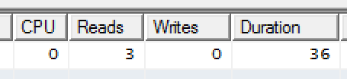
A real-life example
The SQL dumb version, with counts, date, last post calculated at post time and stored in a flat table:
SELECT ForumID, CategoryID, Title, Description,
IsVisible, IsArchived, SortOrder, TopicCount,
PostCount, LastPostTime, LastPostName, UrlName,
ForumAdapterName, IsQAForum
FROM pf_Forum WHERE IsVisible = 1 ORDER BY SortOrder

Slide 16
A real-life example
99.99% reduction in CPU usage
99.83% reduction in disk reads
66% reduction in execution time

Slide 17
A real-life example
These are the results, not under load, of the story that inspired this talk.
About 10k records on parent table, 100k records on child tables.
Database was not CPU or memory bound, but I/O bound under user load of 250+.
Flat table solution load tested to 500 users, performance did not degrade.
There were about 14 places in the code where the hook had to be added to update the flat table. (It was a well-designed app!)
 | Reads | Duration (ms)
12-way join in a view, with aggregates | 574,887 | 1214
Straight select on flat table | 617 | 90
Change | 99.9% | 92.6%

Slide 18
Hidden evil
Exposing EF IQueryable objects to grid controls causes a heap of leaky abstractions. You shouldn’t have to understand how each works, but you do.
Views may act like a table, but they result in a potentially complex world of joins and indexes in the wrong places, or they may require new indexes that adversely affect write performance.
EF’s use of connections inside of transactions can result in the undesirable use of isolation levels set to serializable, which is a diaster of deadlocks and sadness.

Slide 19
Questions?
Feedback is always welcome… jeff@popw.com
Get this deck: https://github.com/jeffputz/presentations

